Slide 1

AI-Powered Software Bug Tracking
and Defect Management System
Team Members:
B SIDHARTH REDDY 2420030600
T DEVI PRASAD 2420030165
M SAI VINESH 2420030691
Name of the Guide:
DR NEELIMA GOGINENI
KL University
Department of Computer Science and Engineering
Project Review Meeting – 2

Slide 2
Project Design
Project Purpose
Proposed System
Develop an intelligent bug tracking system using AI to automatically classify, prioritize, and suggest resolutions for software defects.
Microservices-based architecture with AI engine, bug management service, and real-time notification system.
Main Components
• API Gateway & Authentication Service
• User Management & Bug Service
• AI Analysis & Classification Engine
• Real-time Event Processing with Kafka
• PostgreSQL Data Management

Slide 3
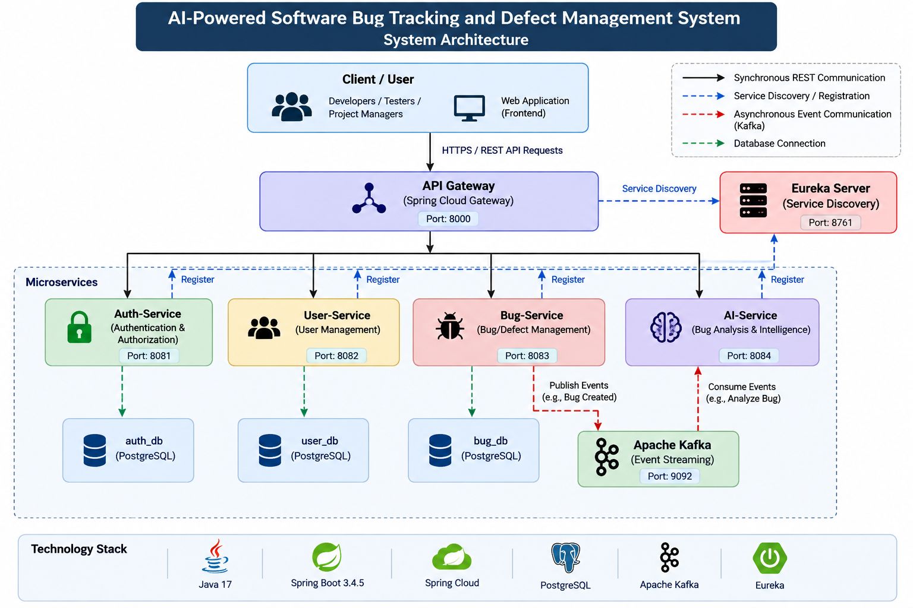
System Architecture
Users
API Gateway
Auth Service
User Service
Bug Service
AI Service
Eureka (Service Discovery)
Kafka (Event Bus)
PostgreSQL (Database)

Slide 4
Methodology Adopted
Requirement
Analysis
System
Design
Microservice
Development
Security &
Integration
Testing
Deployment
Each phase emphasizes:
• Iterative development with continuous feedback
• Security and compliance checks at each stage
• Automated testing and integration practices
• Deployment ready artifacts and documentation

Slide 5
Technical Implementation
Backend Framework
Microservices
Data & Messaging
• Java
• API Gateway
• PostgreSQL
• Spring Boot
• Eureka
• Kafka
• Spring Cloud
• REST APIs
• JSON
• Spring Security
• JWT Auth
• Indexing
Key Technical Features
✓ RESTful APIs for synchronous communication
✓ Kafka for asynchronous event processing
✓ JWT-based authentication and Spring Security
✓ Horizontal scaling with independent microservices
✓ Transactional integrity and indexed queries

Slide 6
Technical Soundness
Area | Implementation
Modularity | Independent microservices with clear bounded contexts
Security | JWT tokens, Spring Security, role-based access control
Communication | REST for synchronous; Kafka for asynchronous events
Service Discovery | Eureka for dynamic discovery and load balancing
Data Management | PostgreSQL with transactional integrity & indexing
Scalability | Horizontal scaling with independent throughput tuning

Slide 7
Conclusion
Project Overview
The AI-Powered Bug Tracking and Defect Management System demonstrates strong technical soundness by applying microservices and Service-Oriented Architecture (SOA) principles.
Key Achievements:
• Modular, scalable architecture enabling independent service evolution
• Enterprise-grade security with JWT and Spring Security
• Event-driven communication supporting real-time processing
• Intelligent bug classification and resolution assistance through AI
• Production-ready deployment model with automated testing and integration
This project exemplifies modern software engineering practices, combining microservices architecture with AI capabilities to deliver an effective defect management solution.

Slide 8
Thank You

